Slide 1
导言II、宏观经济学的基本数据
宏观经济学
中央财经大学2019年春季学期
陈斌开

Slide 2
随处可见的新闻
统计局公布2018年经济数据，2018年GDP增速6.6%，分季度看，一季度同比增长6.8%，二季度增长6.7%，三季度增长6.5%，四季度增长6.4%。2017全年居民消费价格(CPI)比上年上涨2.1%......
失业率为？？2018年各月城镇调查失业率在4.8%-5.1%之间，实现低于5.5%的预期目标。

Slide 3
学习目标
本章概要:
国内生产总值 (GDP)
消费物价指数 (CPI)
失业率
Notes:
These are three of the most important economic statistics. Policymakers and businesspersons use them to monitor the economy and formulate appropriate policies. Economists use them to develop and test theories about how the economy works. Because we’ll be learning many of these theories, it’s worth spending some time now to really understand what these statistics mean, and how they are measured.

Slide 4
GDP

Slide 5
国内生产总值的定义
国内生产总值 (GDP，Gross domestic product)是在某一既定时期一个国家内生产的所有最终物品与劳务的市场价值。
GDP度量一个经济体的总收入与总支出。

Slide 6
经济中总收入与总支出
的相等性
对一个整体经济而言，收入必定等于支出，因为:
  每一次交易都有买者和卖者
  某个买者的1美元支出就是某个卖者的1美元收入

Slide 7
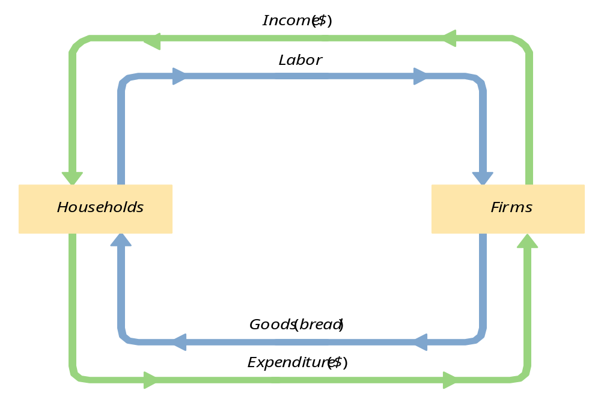
收入、支出的循环流程

Slide 8
GDP三种核算方法
生产法
支出法
收入法

Slide 9
生产法GDP与价值增值
定义:
厂商的价值增值等于它的产出的价值减去它所投入的中间产品的价值.
Notes:
It might be useful here to remind students what “intermediate goods” are.

Slide 10
练习
一个农民种植了1斤小麦，并以1.00美元的价格卖给磨坊主.
磨坊主把小麦磨成面粉，然后以3美元的价格卖给面包师.
面包师用面粉制造面包，并且以6美元的价格卖给一个工程师.
工程师吃了面包.
计算
  每一生产过程的价值增值
  GDP
Notes:
“Compute GDP” assuming, of course, that these are the only transactions in the economy.
Lessons of this problem:
GDP = value of final goods = sum of value at all stages of production
We don’t include the value of intermediate goods in GDP because their value is already embodied in the value of the final goods.
Answer:
Each person’s value-added (VA) equals the value of what he/she produced minus the value of the intermediate inputs he/she started with.
Farmer’s VA = $1
Miller’s VA = $3
Baker’s VA = $3
GDP = $6
Note that GDP = value of final good = sum of value-added at all stages of production.
Even though this problem is highly simplified, its main lesson holds in the real world: the value of all final goods produced equals the sum of value-added in all stages of production of all goods.

Slide 11
最终产品, 价值增值, 与GDP
GDP = 最终产品的价值总和
= 所有生产阶段价值增值的总和
最终产品的价值已经包含了中间产品的价值，所以再将中间产品的价值计入GDP将造成重复计算.

Slide 12
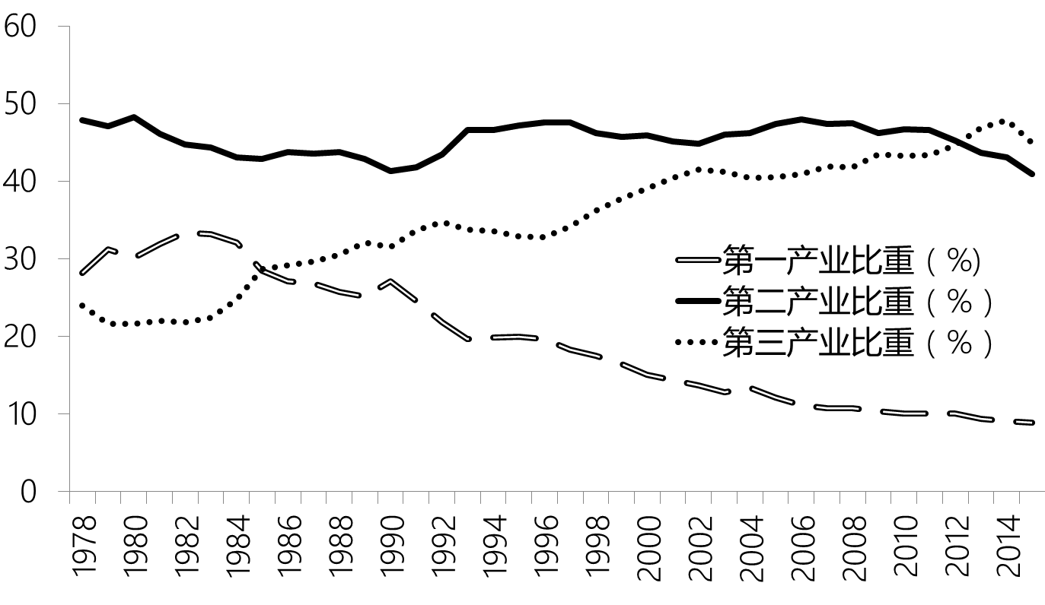
中国生产法GDP
数据来源：《中国统计年鉴2016》

Slide 13
世界主要国家产业结构
世界主要国家产业结构与城乡结构（2013）
国家 | 美国 | 英国 | 德国 | 日本 | 韩国 | 印度 | 巴西 | 中国
第二产业占GDP比重（%） | 21 | 20 | 31 | 26 | 38 | 31 | 24 | 44
服务业占GDP比重（%） | 78 | 79 | 68 | 73 | 59 | 51 | 70 | 47
城镇人口占总人口比重（%） | 81 | 82 | 75 | 92 | 82 | 32 | 85 | 53
数据来源: World Development Indicators (WDI)。

Slide 14
支出法GDP：
总支出的组成部分
消费
投资
政府购买（government spending）
净出口

Slide 15

消费 (C)
定义: 家庭购买的所有产品和服务的价值. 包括:
  耐用品: 可以长期使用的产品，如汽车和电视
  非耐用品
  ：使用时间较短的产品: 食物和衣服
  服务
  个人和企业为消费者所做的工作: 干洗，航空旅行
Notes:
A consumer’s spending on a new house counts under investment, not consumption. More on this in a few moments, when we get to Investment.
A tenant’s spending on rent counts under services -- rent is considered spending on “housing services.”
So what happens if a renter buys the house she had been renting? Conceptually, consumption should remain unchanged: just because she is no longer paying rent, she is still consuming the same housing services as before.
In national income accounting, (the services category of) consumption includes the imputed rental value of owner-occupied housing.
To help students keep all this straight, you might suggest that they think of a house as a piece of capital which is used to produce a consumer service, which we might call “housing services”. Thus, spending on the house counts in “investment”, and the value of the housing services that the house provides counts under “consumption” (regardless of whether the housing services are being consumed by the owner of the house or a tenant).

Slide 16
投资 (I)
定义 1: 花费于资本品 [生产要素] 的支出
定义 2: 为未来使用而购买的产品
包括:
  企业固定投资
  企业购买的新工厂和设备（不同于中间产品）
  住房固定投资
  家庭和房东购买的新住房
  存货投资
  企业产品存货的增加（减少就是负投资）
Notes:
In definition #1, note that aggregate investment equals total spending on newly produced capital goods. (If I pay $1000 for a used computer for my business, then I’m doing $1000 of investment, but the person who sold it to me is doing $1000 of disinvestment, so there is no net impact on aggregate investment.)
The housing issue
A consumer’s spending on a new house counts under investment, not consumption.
A tenant’s spending on rent counts under services -- rent is considered spending on “housing services.”
So what happens if a renter buys the house she had been renting? Conceptually, consumption should remain unchanged: just because she is no longer paying rent, she is still consuming the same housing services as before.
In national income accounting, (the services category of) consumption includes the imputed rental value of owner-occupied housing.
To help students keep all this straight, you might suggest that they think of a house as a piece of capital which is used to produce a consumer service, which we might call “housing services”. Thus, spending on the house counts in “investment”, and the value of the housing services that the house provides counts under “consumption” (regardless of whether the housing services are being consumed by the owner of the house or a tenant).
Inventories
If total inventories are $10 billion at the beginning of the year, and $12 billion at the end, then inventory investment equals $2 billion for the year.
Note that inventory investment can be negative (which means inventories fell over the year).

Slide 17
概念区分：哪些是投资？
买股票
买新房
买二手房

Slide 18
GDP的组成部分
政府购买 (G):
  各级政府用于物品与劳务的支出，包括政府员工的薪水和用于公务的支出。
  政府购买不包括转移支付，因为这种支付并不要求交换现在生产的物品与劳务。
净出口 (NX):
  出口减进口

Slide 19
一个重要的恒等式
Y = C + I + G + NX
这里
Y = GDP = 总产出的价值
C + I + G + NX = 总支出
Notes:
A few slides ago, we defined GDP as the total expenditure on the economy’s output of goods and services (as well as total income). We can also define GDP as (the value of) aggregate output, not just spending on output.
An identity is an equation that always holds because of the way the variables are defined.

Slide 20
为什么总产出 = 总支出
没有卖出的产品变成库存，
计为库存投资…
不管库存积累是意愿的还是非意愿的.
实际上，我们假设企业自己购买了它没有卖出去的产品.

Slide 21
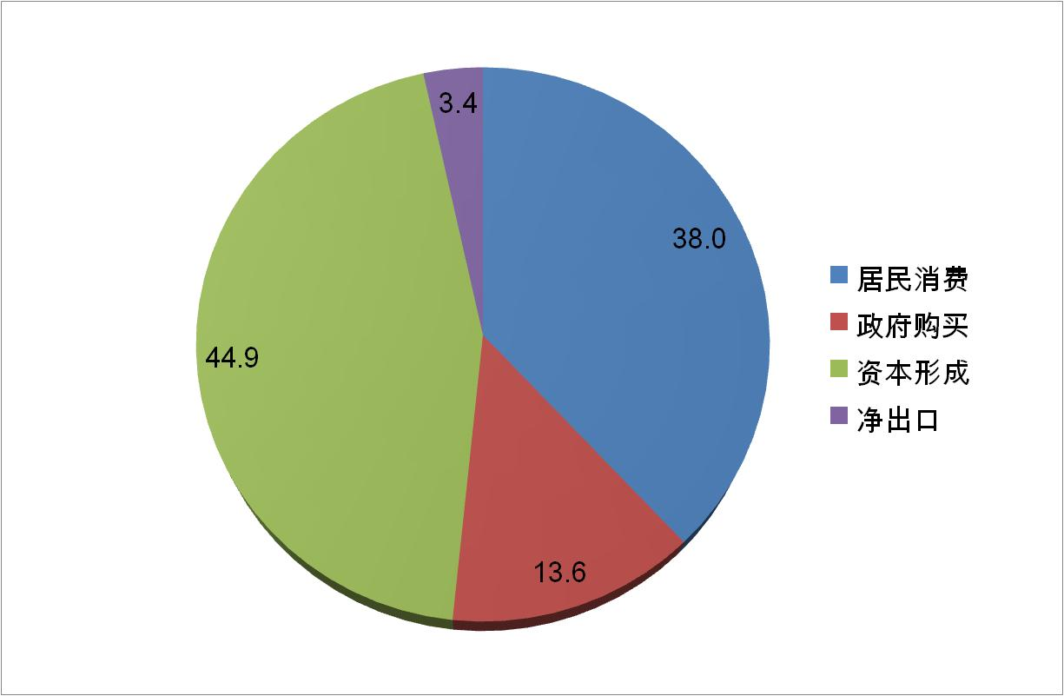
中国支出法GDP(2015)
数据来源：《中国统计年鉴2016》

Slide 22
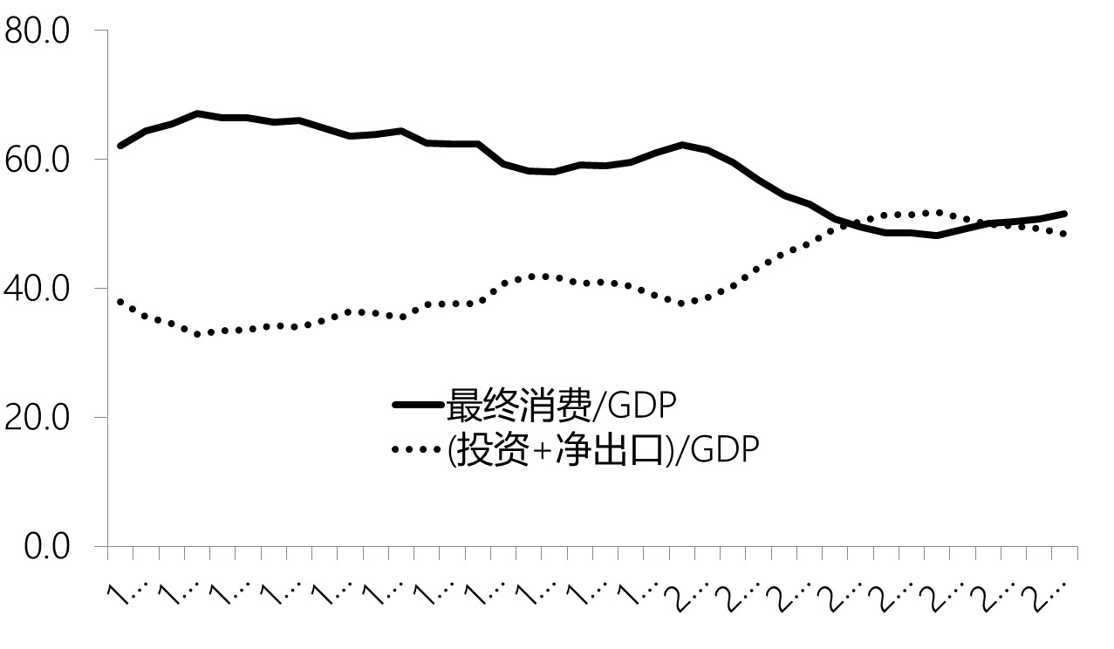
中国GDP构成的变化趋势：1978～2015
数据来源：《中国统计年鉴2016》

Slide 23
世界主要国家需求结构
世界主要国家需求结构（2013）
国家 | 美国 | 英国 | 德国 | 日本 | 韩国 | 印度 | 巴西 | 中国
最终消费率（%） | 84 | 85 | 75 | 82 | 66 | 70 | 82 | 51
居民消费率（%） | 68 | 65 | 56 | 61 | 51 | 59 | 62 | 37
净出口率（%） | -3 | -2 | 6 | -3 | 5 | -3 | -2 | 3
数据来源: World Development Indicators (WDI)，经作者计算得到。
注：最终消费率是指（总消费/GDP）；居民消费率是指（居民消费/GDP）；
净出口率为商品和服务出口占GDP比重减去商品和服务进口占GDP比重；
外汇储备比重为外汇储备总额（不包含黄金储备）占GDP比重。

Slide 24
收入法GDP
家庭收入
企业收入
政府收入

Slide 25
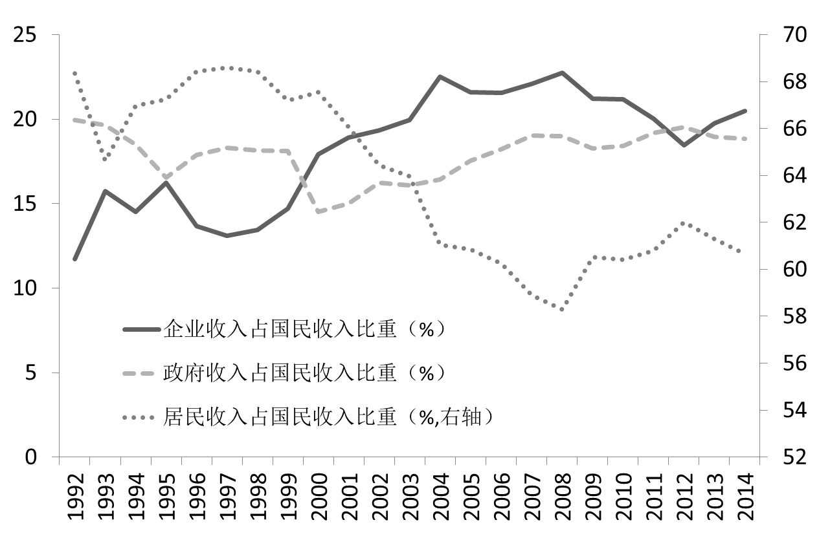
中国收入法GDP
数据来源：国家统计局

Slide 26
世界主要国家国民收入分配结构：2010
国家 | 美国 | 英国 | 日本 | 印度 | 巴西 | 中国
住户部门初次分配收入（不包括财产收入）占国民总收入比重（%） | 74 | 63 | 61 | 71 | 58 | 55
住户部门初次分配收入占国民总收入比重（%） | 81 | 71 | 65 | 81 | 64 | 57
住户部门可支配收入占国民可支配总收入比重（%） | 76 | 61 | 60 | 81 | 62 | 57
数据来源：原始数据来自联合国统计数据库（UNdata），经作者计算得到，
德国和韩国数据缺失。原始数据下载地址：http://unstats.un.org/unsd/nationalaccount/madt.asp。

Slide 27
GDP:
一个重要而又多面的概念
我们现在看到 GDP 意味着
  总收入
  总支出
  总产出
  生产最终产品的所有生产阶段的价值增值的总和.
Notes:
This is why economists often use the terms income, output, expenditure, and GDP interchangeably.

Slide 28
GNP 与 GDP
国民生产总值（Gross National Product，GNP):
一国生产要素所赚取的总收入， 而不管它来自什么地方
国内生产总值 (GDP):
国内生产要素所赚取的总收入，而不管这一要素是否归本国国民所有。
(GNP – GDP) = (来自国外的要素收入)
– (对国外的要素支付)
Notes:
Emphasize that the difference b/w GDP and GNP boils down to two things:
location of the economic activity, and ownership (domestic vs. foreign) of the factors of production.
From the perspective of the U.S., factor payments from abroad includes things like
wages earned by U.S. citizens working abroad
profits earned by U.S.-owned businesses located abroad
income (interest, dividends, rent, etc) generated from the foreign assets owned by U.S. citizens
Factor payments to abroad includes things like
wages earned by foreign workers in the U.S.
profits earned by foreign-owned businesses located in the U.S.
income (interest, dividends, rent, etc) that foreigners earn on U.S. assets
Chapter 3 introduces factor markets and factor prices. Unless you’ve already covered that material, it might be worth mentioning to your students that factor payments are simply payments to the factors of production, for example, the wages earned by labor.

Slide 29
实际与名义 GDP
GDP 是所有生产的最终产品和服务的市场价值
名义GDP（Nominal GDP） 是用现期价格计算的价值.
实际GDP（Real GDP） 是用基期年价格计算的价值.

Slide 30
实际GDP 控制了通货膨胀
名义GDP的变化由于两个方面:
  物价的变化
  最终产品数量的变化
实际GDP的变化只是由于产品数量的变化引起的
因为实际GDP是用基期年不变价格计算的.
Notes:
Suppose from 2002 to 2003, nominal GDP rises by 10%. Some of this growth could be due to price increases, because an increase in the price of output causes an increase in the value of output, even if the real quantity remains the same.
Hence, to control for inflation, we use real GDP. Remember, real GDP is the value of output using constant base-year prices. If real GDP grows by 6% from 2002 to 2003, we can be sure that all of this growth is due to an increase in the economy’s actual production of goods and services, because the same prices are used to construct real GDP in 2002 and 2003.

Slide 31
计算题，part 1
 | 2014 |  | 2015 |  | 2016
 | P | Q | P | Q | P | Q
good A | $30 | 900 | $31 | 1,000 | $36 | 1,050
good B | $100 | 192 | $102 | 200 | $100 | 205
计算每年的名义GDP
计算每年的实际GDP（以2014年为基期年）.
Notes:
This slide (and a few of the following ones) contain exercises that you can have your students do in class for immediate reinforcement of the material. These problems require calculators (well,
This problem requires calculators. If most of your students do not have calculators, you might “hide” this slide and instead pass out a printout of it for a homework exercise. Tell students that if they don’t have Or: just have them write down the expressions that they would enter into a calculator if they had calculators, i.e. Nominal GDP in 2001 = 30*900 + 100*192.

Slide 32
解答, part 1
名义 GDP 用同一年的价格乘以数量
2014: $46, 200 = $30 × 900 + $100 × 192
2015: $51, 400
2016: $58, 300
实际 GDP 用2014年的价格乘以每年的数量
2014: $46, 200
2015: $50, 000
2016: $52, 000 = $30 × 1050 + $100 × 205

Slide 33
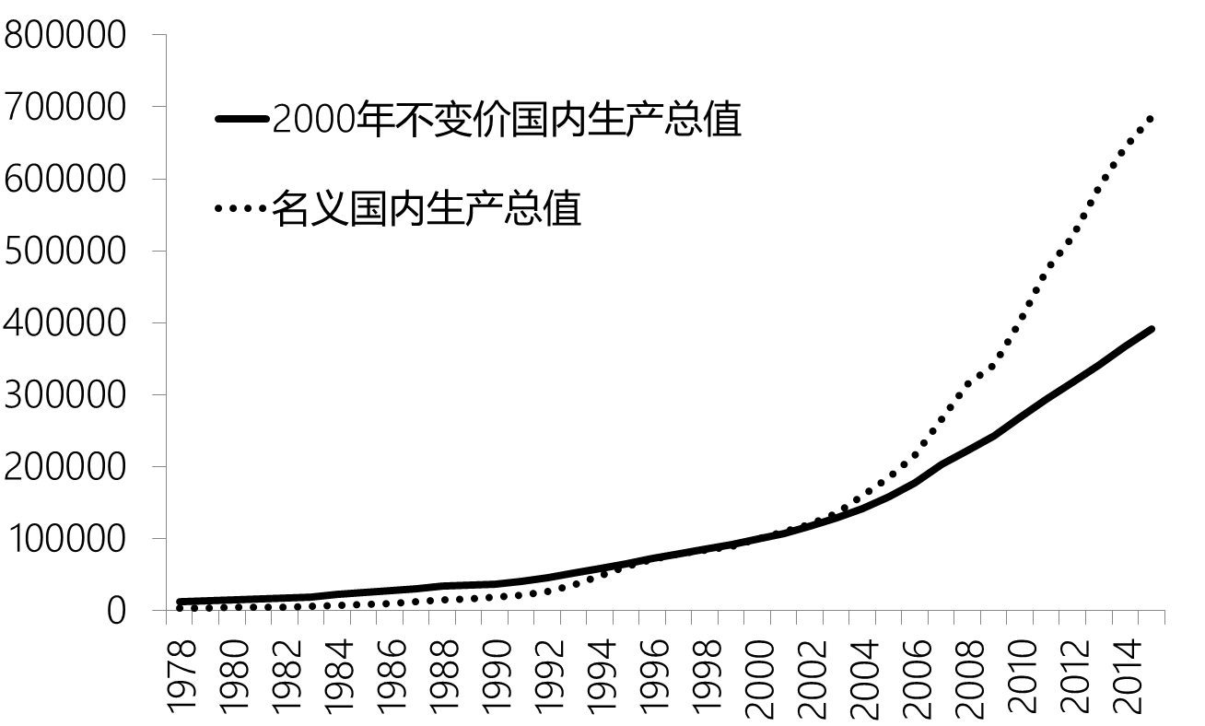
中国的实际与名义GDP
数据来源：《中国统计年鉴2016》
Notes:
Notice that the blue line (NGDP) is steeper than the red line. That’s because prices generally rise over time. So, nominal GDP grows at a faster rate than real GDP.
If you’re anal like me, you might ask students what is the significance of the two lines crossing in 1996.
Answer: 1996 is the base year for this real GDP data, so RGDP = NGDP in 1996 only.
Before 1996, RGDP > NGDP, while after 1996, RGDP < NGDP. This is intuitive if you think about it for a minute.
Take 1970. When the economy’s output of 1970 is measured in the (then) current prices, GDP is about $1 trillion. Between 1970 and 1996, most prices have risen. Hence, if you value the country’s 1970 using 1996 prices (to get real GDP), you get a bigger value than if you just measure 1970’s output in 1970 prices (nominal GDP).

Slide 34
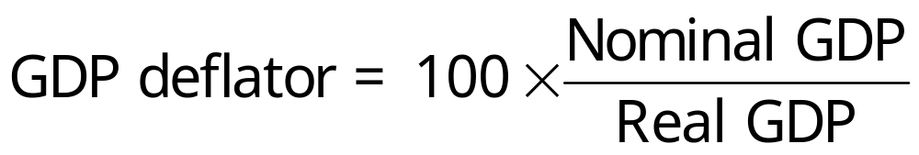
GDP 平减指数（Deflator）
通货膨胀率是价格总体水平上涨的百分比.
衡量价格水平的指标之一是GDP平减指数，定义为
Notes:
After revealing the first bullet point, mention that there are several different measures of the overall price level. Your students are probably familiar with one of them---the Consumer Price Index, which will be covered shortly. For now, though, we learn about a different one <reveal next bullet point>, the GDP deflator.
The GDP deflator is so named because it is used to “deflate” (remove the effects of inflation from) GDP and other economic variables.

Slide 35
练习， part 2
 | 名义GDP | 实际GDP | GDP deflator | 通货膨胀率
2014 | $46,200 | $46,200 |  | n.a.
2015 | 51,400 | 50,000
2016 | 58,300 | 52,000
用你先前的答案来计算每年的GDP平减指数.
利用GDP平减指数来计算 2014年到 2015年及2015年到2016年的通货膨胀率.

Slide 36
练习, part 2
 | Nom. GDP | Real GDP | GDP deflator | Inflation rate
2014 | $46,200 | $46,200 | 100.0 | n.a.
2015 | 51,400 | 50,000 | 102.8 | 2.8%
2016 | 58,300 | 52,000 | 112.1 | 9.1%

Slide 37
CPI

Slide 38

一、什么是消费物价指数
消费物价指数 (Consumer Price Index, CPI)是普通消费者所购买的物品与劳务的总费用的衡量标准。
它被用来监测生活费用随着时间的变化情况。

Slide 39
二、如何计算消费物价指数
1.固定篮子
确定哪些物价对普通消费者是最重要的。
根据消费者购买每种物品和劳务的数量来确定加权。

Slide 40
2.找出价格：找出每个时点上篮子中每种物品与劳务的价格。
3.计算这一篮子东西的费用：用价格数据计算不同时点一篮子物品与劳务的费用。

Slide 41
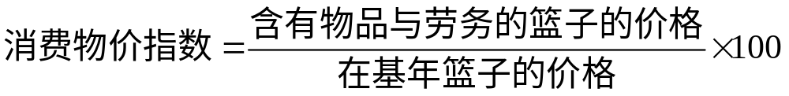
4.选择基年并计算指数:
  指定一年为基年，即其他各年与之比较的基准。
  每年一篮子物品与劳务的价格除以基年该篮子物品与劳务的价格，然后把这个比率乘以100，所得出的数字就是消费物价指数。

Slide 42
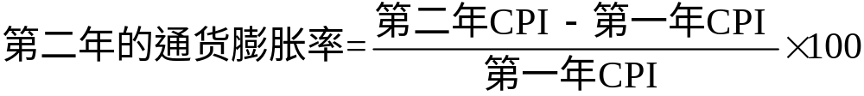
5. 计算通货膨胀率：通货膨胀率是从上一年以来物价指数的变动百分比。
通货膨胀率计算如下:

Slide 43
中国CPI的“篮子”
总体 | 100
食品 | 33.60
非食品 | 66.40
烟酒 | 4.50
衣服 | 9.00
家庭设备和家庭服务 | 6.50
医疗保健 | 9.20
交通通讯 | 9.10
教育、文化和娱乐 | 14.50
居住 | 13.60

Slide 44
讨论
中国的CPI与房价

Slide 45
三、GDP平减指数与
消费物价指数的区别
经济学家和政策制订者为了估计物价上升有多快，即要关注GDP平减指数，又要关注消费物价指数。
但这两个物价指数并不完全一致，原因有二：

Slide 46
原因一
GDP 平减指数反映了国内生产的所有物品与劳务的价格，而...
… 消费物价指数反映普通消费者购买的所有物品与劳务的价格。
例子1：飞机是GDP的一部分，但不计入消费物价指数；
例子2：进口消费品价格反映在消费物价指数，但不计入GDP平减指数。
Notes:
20

Slide 47
原因二
消费物价指数 比较固定的一篮子物品与劳务的价格与基年这一篮子物品与劳务的价格...
…而GDP平减指数比较现期生产的所有物品与劳务的价格与基年同样物品与劳务的价格。因此，用来计算GDP平减指数的物品和劳务的组合会自动随时间而变化。
Notes:
20

Slide 48
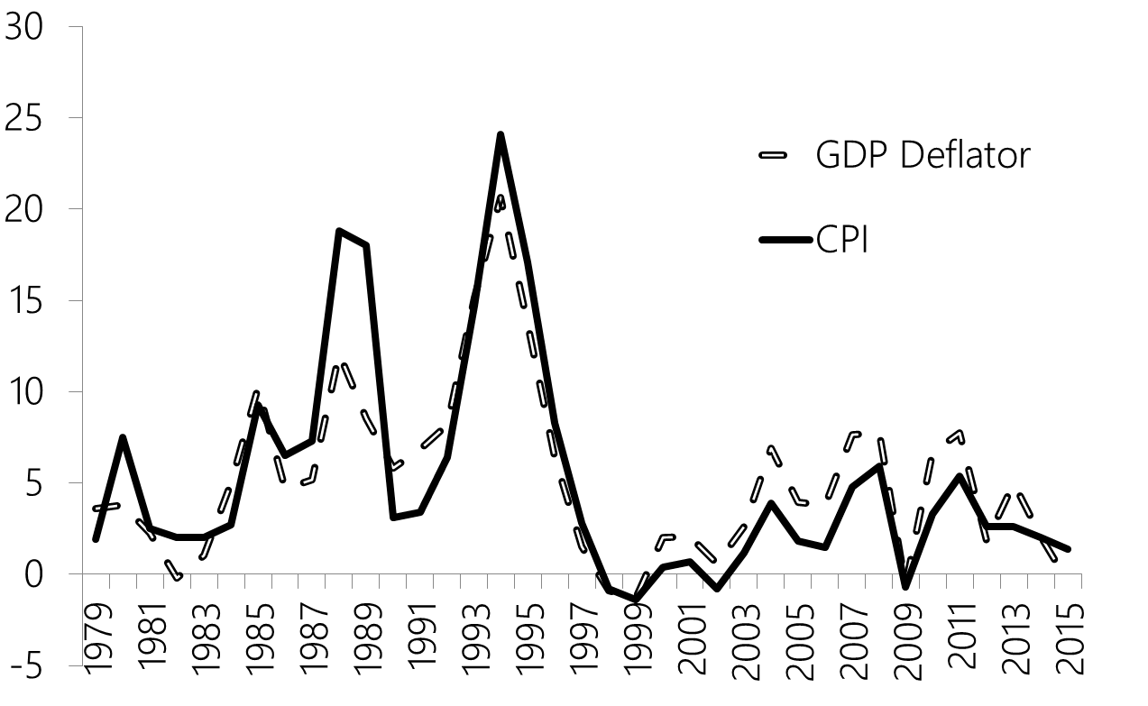
中国GDP Deflator 与CPI
数据来源：《中国统计年鉴2016》

Slide 49
失业率

Slide 50
人口分类与失业率
就业
拥有有报酬的工作
失业
没有工作但正在寻找工作
劳动力（labor force）
可用于生产产品和服务的劳动数量；为就业者与失业者之和。
不属于劳动力
没有雇佣，也不寻找工作的人.

Slide 51
本章总结
国内生产总值 (GDP) 既衡量经济中所有人的收入，又衡量对经济生产出来的产品与服务的总支出.
名义 GDP用现期价格估价产品与服务；实际 GDP 用不变价格估价产品与服务. 产出的增加两者都影响，但价格变化只影响名义GDP.
GDP 是四种支出之和：消费、投资、政府购买和净出口。

Slide 52
本章总结
总体价格水平变化可用以下两个指标表示：
  消费价格指数 (CPI) 衡量一个典型消费者购买的固定的一篮子产品与服务的价格
  GDP平减指数
  名义与实际GDP之比
失业率表明想要工作而没有工作的人的比例有多少.

Slide 53
谢谢！

